Slide 1
EMPLOYEE
ATTRITION
ANALYTICS
PLATFORM
Predicting who may leave, and what HR can do about it
Shrinivas Wable
PRN No: 2124UDSM2065
Notes:
Introduce the project and myself. The project predicts employee attrition and delivers a dashboard and API.

Slide 2
The problem
1470
237
16.1%
HR finds out when the resignation letter arrives. That is too late.
employees
left the company
attrition rate
Goal: give every employee a risk score and a Low, Medium or High band.
A model that always says "stays" would be 84% accurate and useless, so I judge models on recall, F1 and ROC-AUC.
Deliver it as a dashboard, a REST API and a model that retrains itself.
Notes:
Attrition costs money and HR hears about it late. The dataset has 1,470 employees and about one in six left.

Slide 3
Data and preparation
1470 rows, 35 columns, no missing values.
Dropped 4 columns that carry no information (IDs and constants).
Numbers standardised, text one-hot encoded.
75% train / 25% test, stratified, seed 7.
Five new features
IncomeToLevel pay relative to grade
TenureRatio time here vs career length
PromotionGap years waiting for promotion
StabilityScore years per employer
All feature code lives in one file, hr_features.py, shared by the notebook, dashboard and API.
SatisfactionIndex mean of 4 ratings
Notes:
Explain the five engineered features and the stratified split.

Slide 4
What the data says
30.5%
left among overtime workers vs 10.4% without overtime
29.8%
left within their first 2 years (vs 8.1% after 11 years)
29.3%
in the lowest income quarter (vs 10.3% in the top)
Notes:
Overtime and job role stand out. Walk through the chart and the callouts.

Slide 5
Seven models, one winner
Reading the results
Top four are close: 0.808, 0.783, 0.78, 0.779.
The neural network has the best accuracy (0.87) but recall of only 0.458.
Simple wins: fast, stable and easy to explain.
Notes:
Logistic regression had the best cross-validated AUC. The simple model matched the complex ones, so it is the better choice.

Slide 6
Bayes and discriminant analysis
Naive Bayes
LDA and QDA
P(left | x) ∝ P(x | left) × P(left)
Assume normal classes
Prior: 16.2% of employees leave.
Leavers: lower job level, income, experience and satisfaction; longer commute.
Recall 0.576, precision 0.386, AUC 0.75 (lowest).
Job level, income and experience move together, so independence fails.
Skewness above 1.5 for StabilityScore and YearsSincePromotion.
Class covariances fairly similar (0.18).
LDA: AUC 0.785, recall 0.186. QDA: AUC 0.791, recall 0.305.
Kept for comparison only.
Notes:
Prior of 16 percent updated by likelihood. LDA assumptions fail because features are skewed.

Slide 7
Final model and risk bands
Logistic Regression
0.67
0.661
0.557
0.855
model
threshold
recall
precision
ROC-AUC
Threshold 0.67 lifts precision from 0.387 to 0.557 and F1 from 0.517 to 0.605.
Recall drops from 0.78 to 0.661: about two of three leavers are still found.
Scores are out-of-fold: no one is scored by a model that saw them.
Notes:
Threshold chosen to maximise F1. Show the three risk bands and how much they separate.

Slide 8
Deployment
GitHub
Streamlit
Render
GitHub Actions
code, model, history
dashboard + prediction
FastAPI + /docs page
weekly retraining
github.com/shrinivas090605/employee-attrition-platform
employee-attrition-platform-i7ymnicw7iichr9je4kvbe.streamlit.app
employee-attrition-platform-yaou.onrender.com/docs
every Monday, or on demand
POST /predict takes raw employee fields and returns probability, risk band and a yes/no prediction.
Retraining keeps the old model unless the new cross-validated AUC is about as good.
If the server has a different scikit-learn version, the app rebuilds the model by itself.
Notes:
As instructed, Watson was replaced by free tools: GitHub, Streamlit, Render and GitHub Actions.

Slide 9
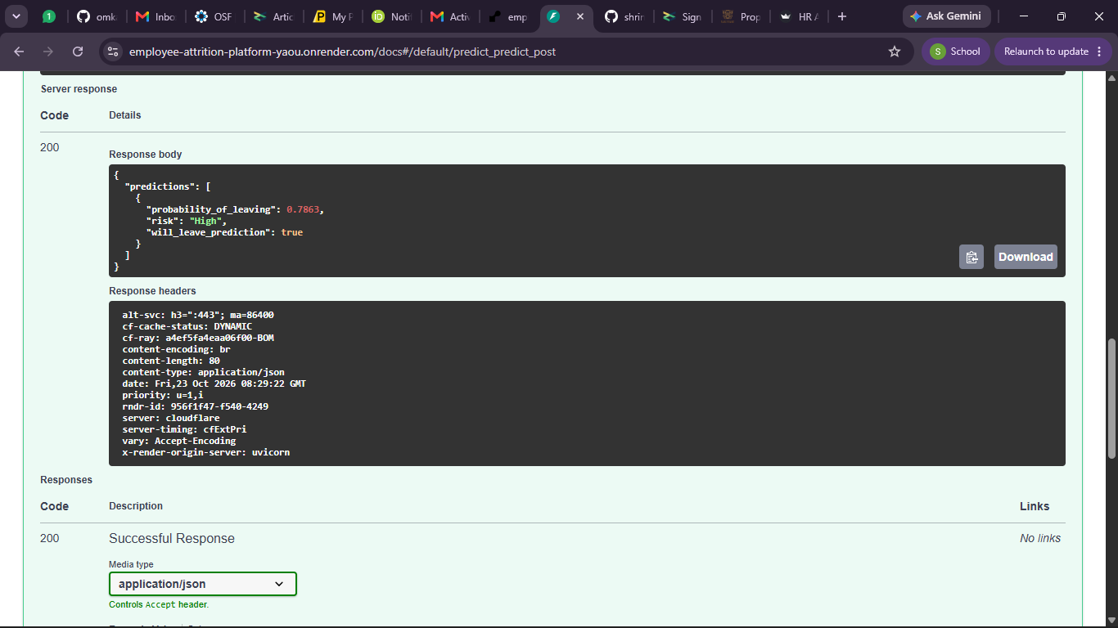
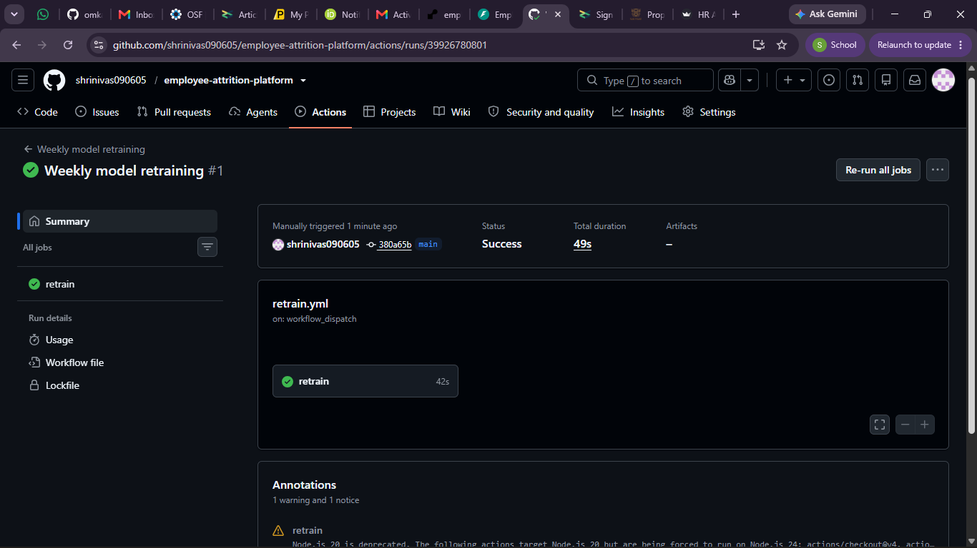
Live deployment evidence
POST /predict returns 0.7863, risk High
Retraining workflow run #1: Success, 49 s
Test input: 29-year-old, level 1, Sales, overtime, income 3,200, frequent travel. Result: 78.6% chance of leaving, High risk.
Notes:
Show the API response with 0.7863 probability and the successful retraining run.

Slide 10
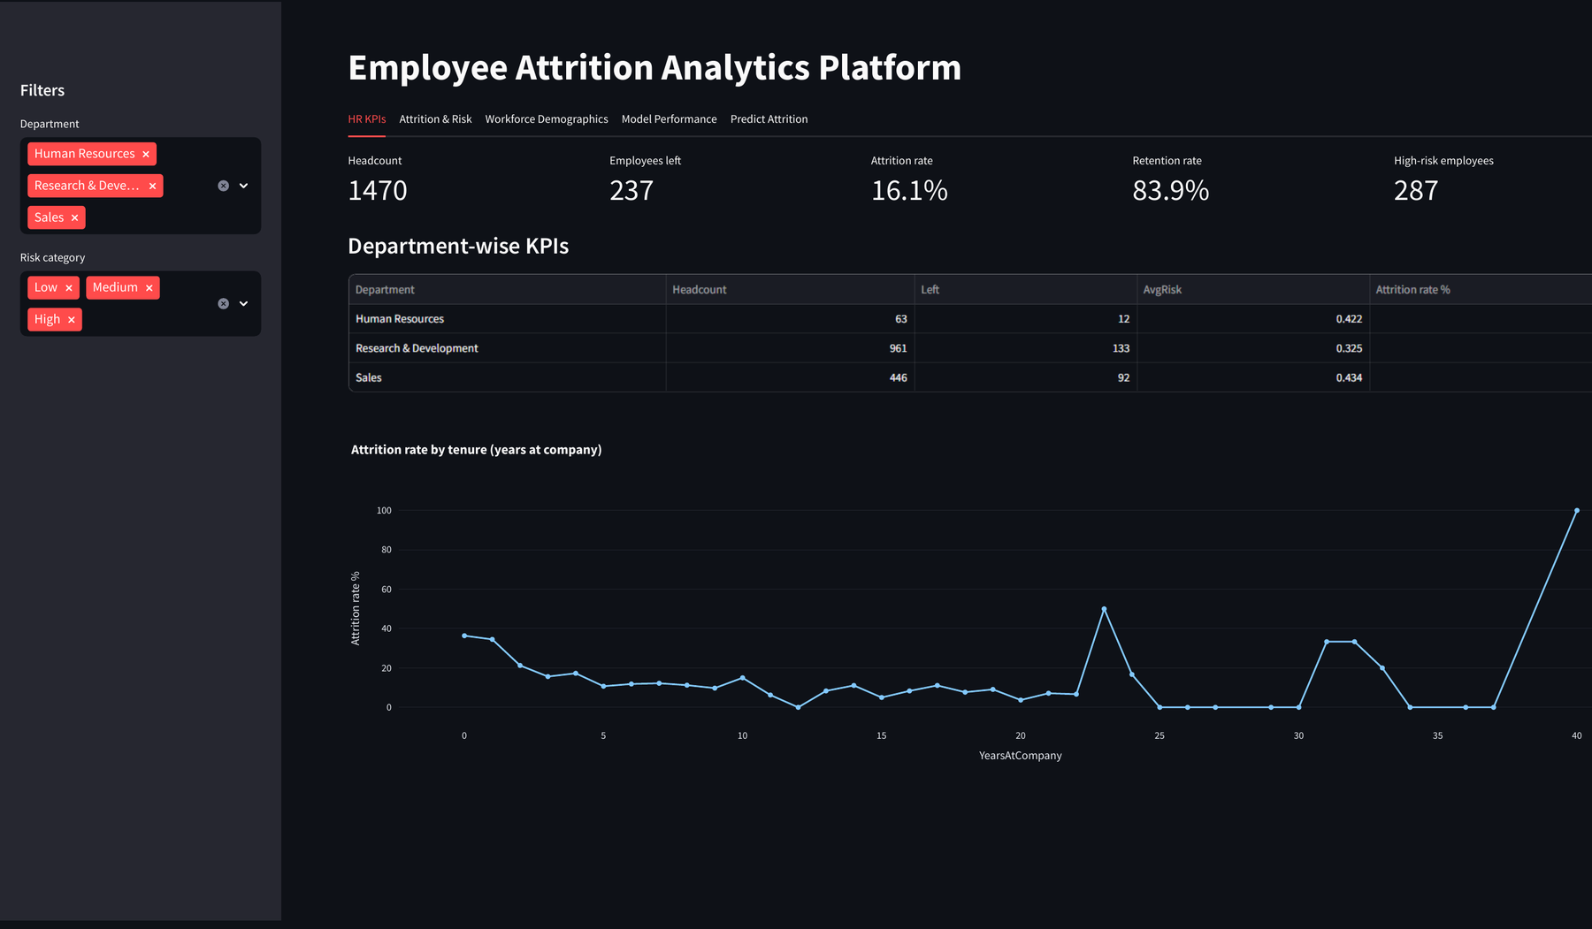
HR dashboard
Five tabs
HR KPIs
Attrition and Risk
Workforce Demographics
Model Performance
Predict Attrition
Filters: department and risk category
employee-attrition-platform-i7ymnicw7iichr9je4kvbe.streamlit.app
Paste a screenshot of the dashboard here
Notes:
Demo the live dashboard if possible.

Slide 11
Recommendations and impact
Cut long-term overtime, starting with teams that have many High-risk staff.
Mentor and check in with employees in their first two years.
Review pay for Sales Representatives and Laboratory Technicians.
Offer stock options or retention bonuses to High-risk staff who have none.
Reduce frequent travel by rotating trips or meeting online.
Use the High-risk list for monthly support conversations, never for penalties.
287
employees in the High band; about 143 did leave
Keep 25% of them and about 36 exits are avoided
Illustration only: the 25% is an assumption.
Notes:
Tie each recommendation to a finding. The saving is an illustration based on two stated assumptions.

Slide 12
Thank you!!
Notes:
Be honest: nearly half of High-risk flags are false alarms, so the list is for conversations only.

